Slide 1
Towards a
Foundational Framework for
Embodied Interaction
Paul Dourish
Xerox Palo Alto Research Center
dourish@parc.xerox.com

Slide 2
Overview
Theory and foundations
Tangible Computing
Social Computing
Embodiment
Embodiment and Phenomenology
Framework
Design Principles

Slide 3
Theory and Foundations
A history of HCI and interaction paradigms
  electronic
  symbolic
  textual
  graphical
A history of conceptual & theoretical models
  incorporating new human skills and abilities
  incorporating new ways of understanding their use

Slide 4
Two Recent Trends
“Tangible computing”
  physical interaction
  augmented environments
  computation as part of the physical world
“Social computing”
  using social understandings of interaction
  enhancing interaction with computation

Slide 5
Tangible Computing
Origins in Ubiquitous Computing
  computation moves into the environment
  interface moves into the environment
  new set of design concerns
    managing attention
    incorporating context
    combining devices
    new physical forms and affordances
    new interactive styles

Slide 6
Tangible Computing
Wellner’s Digital Desk
Jeremijenko’s Live Wire
Bishop’s Marble Answering Machine

Slide 7
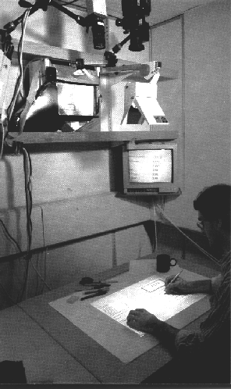
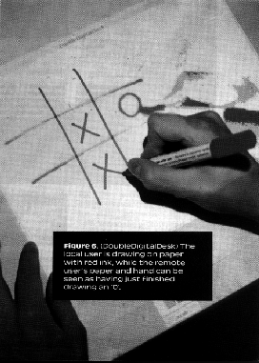
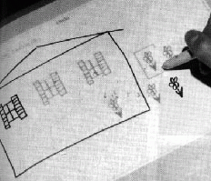
Tangible Computing
Wellner’s digital desk
  interaction with paper and electronic documents

Slide 8
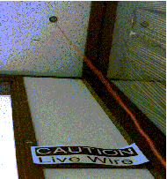
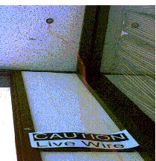
Tangible Computing
Jeremijenko’s “Live Wire”
  bridging physical and virtual

Slide 9

Tangible Computing
Bishop’s Marble Answering Machine
  physical interaction with digital information

Slide 10
Tangible Computing
Metadesk
Illuminating Light
Urp
Triangles

Slide 11


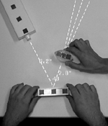

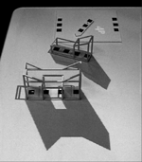
Tangible Computing

Slide 12
Features of Tangible Computing
Physical mappings
  physical objects rather than abstract entities
  specificity and specialisation
Exploiting physical affordances
  suggesting and guiding action
Distributed interaction
  interaction across a range of objects
  interaction spread throughout a space
  moving beyond enforced sequentiality

Slide 13
Social Computing
Incorporating sociological understandings
  context: organisational, cultural, etc.
    “From Human Factors to Human Actors”
  the design of interaction
  the improvised sequential organisation of conduct
Two major styles
  design-focussed
  theoretically-focussed

Slide 14
Social Computing
example: ethnography in Air Traffic Control
  focus on the work and the setting of the work
  two roles of flight strips
    a representational role
    a coordinational role
  making work visible
    “cocking out” the strip
    public availability of action over flight strips
    strips as a record of history
  work and the setting are intertwined

Slide 15
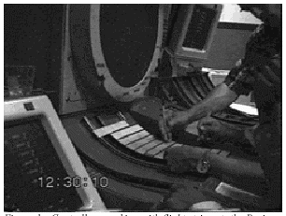
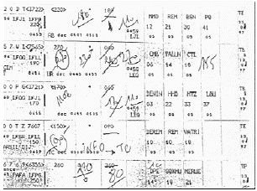
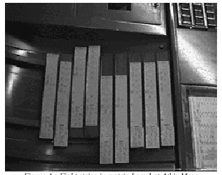
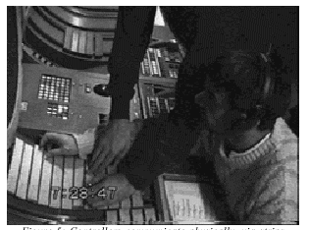
Social Computing

Slide 16
Social Computing
Design-focussed social computing
  gathering field data and studying working settings
  analytic interpretation of data drives design
  field workers as a “proxy” for the work site
Foundationally-focussed social computing
  organised around foundational issues rather than specific designs

Slide 17
Social Computing
Accountability and abstraction
  accountability in ethnomethodology
    actions are organised so as to reveal the kinds of actions they are (e.g. “Hello!”)
  abstraction in software design
    modularity and information hiding
  abstraction in user interface design
    hiding information
  “accounts” are representations that systems offer of their own activity

Slide 18
Features of Social Computing
Beyond single-user interactions
  users act in cultural, social, organisational contexts
Orientation towards settings
  where and how work gets done
Focus on practices

Slide 19
A Common Theme
Exploiting human skills and experiences
Direct participation in the world
  a world of physical and social reality
  unfolding in time and space
Focussing on context
  settings in which action unfolds
  how action is related to those settings

Slide 20
Embodiment
Embodiment in physical computing
Embodiment in social computing
Embodiment is…
  the nexus of presence and practice
  a feature of engaged participation with the world
  a pre-ontological apprehension of the world

Slide 21
Embodiment & Phenomenology
Phenomenology
  study of the phenomena of experience
Edmund Husserl
Martin Heidegger
Alfred Schutz
Ludwig Wittgenstein

Slide 22
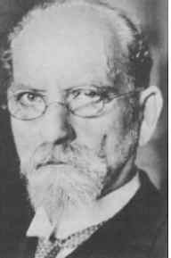
Husserl
The crisis of galilean science
A philosophy of experience
  turning towards “the things themselves”
  experience rather than abstraction
The structure of intentionality and the life-world
  external and internal phenomena
    perceptual and cognitive
  how are meaning, memory and cognition manifest as elements of our experience?

Slide 23
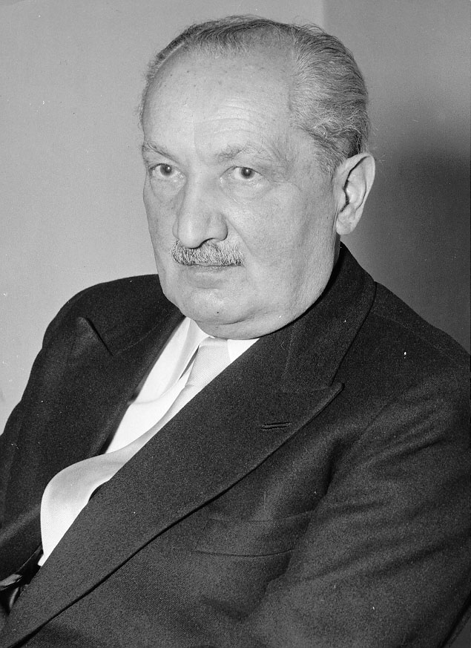
Heidegger
Rejected Husserl’s cartesianism
  Husserl retained a separation
  between inner mental life and the
  outside world
Dasein
  being-in-the-world
  the nature of human experience is based in engaged participation in the world
  theory no longer prior to practice

Slide 24
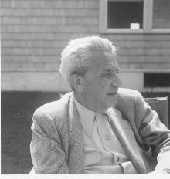
Schutz
The lived world is shared
  social conduct arises within the
  frame of everyday reality
The problem of intersubjectivity
  sociology traditionally places orderly nature of
  social interaction outside the interaction itself
  phenomenology argues it is to be found inside, in the lived experience of social action

Slide 25

Wittgenstein
Career phases
  early work on mathematical logic
  later work on language philosophy
From truth conditions to adequacy conditions
  relationship between meaning and practice
  language-games
  “the meaning of a word is its use in the language”

Slide 26
Relating Meaning and Action
The Cartesian view
  meaning is the province of the mental
  actions are meaningful because we observe and give them meaning
  action arises from meaning
    the expression of internal mental states

Slide 27
Relating Meaning and Action
The Phenomenological view
  we act in a world that is already has meaning
    meaning in my relation to the world
    meaning that reflects social practice and history
  meaning arises from action
    the way I encounter the world gives it meaning for me
    the way I act in the world reflects different meanings
    experience and interaction come before meaning

Slide 28
Relating Meaning and Action
Meaning as a focus for embodiment
  embodiment focuses on participation & action
New questions for tangible & social computing
  how do artifacts reflect and convey meaning?
  how do people create and communicate meaning?
  how does meaning arise in interaction?

Slide 29
Three Aspects of Meaning
Intentionality
  the directedness of meaning
Ontology
  describing the “furniture of the world”
  separating and relating entities, concepts, objects
Intersubjectivity
  how can two people share meaning?
    how do you know what I mean?

Slide 30
Intentionality and Coupling
Intentionality and action
  action is directed towards something
  “reaching through” technologies
Relies on coupling
  relating entities for the purpose of action
    creating and breaking relationships
  the focus of intention
    centered on action, not technology
Notes:
making the world safe for action
example -- email.

Slide 31
Ontology and Interaction
Structure of the world
  our relationship to it
  our activities within it
Ontology is an outcome of interaction
  multiple interactions, multiple people -> multiple ontologies
  reframing design
    ontology is something to be interactionally developed
    designs can reflect ontologies, but not provide them

Slide 32
Intersubjectivity and Practice
Meaning develops in practice
  practices are shared in communities
Meaning is communicated through artifacts
  across time, across space
  re: the “awareness” problem in CSCW
Making action meaningful -> making it visible

Slide 33
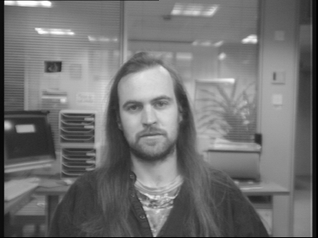
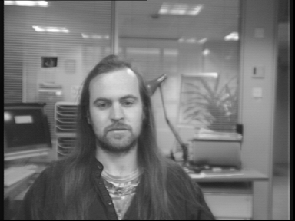
Example: Media Space
Developing practices for a new medium
  eye contact and gaze awareness
  learning to “point” through the technology
  media space as a hybrid space

Slide 34
Example: Media Spaces
Embodiment in media space
  the emergence of new communicative practices
    new forms of coupling
    new expressions of meaning around details of medium
  encountering artifacts
    settings and the frames of the monitor
    formulating the medium as part of the interaction
  sharing meaning
    practices as shared phenomena
    interactionally, intersubjectively meaningful

Slide 35
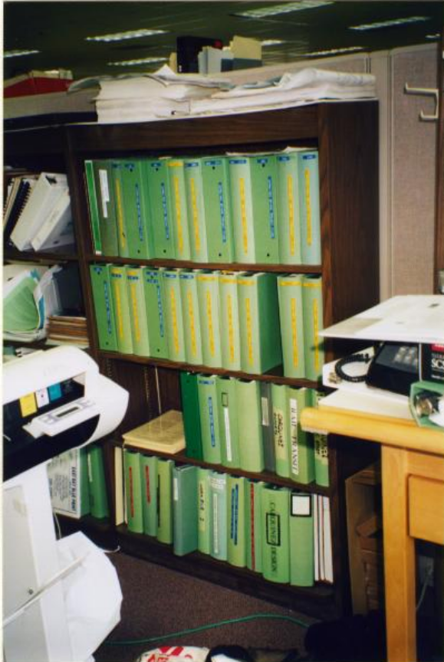
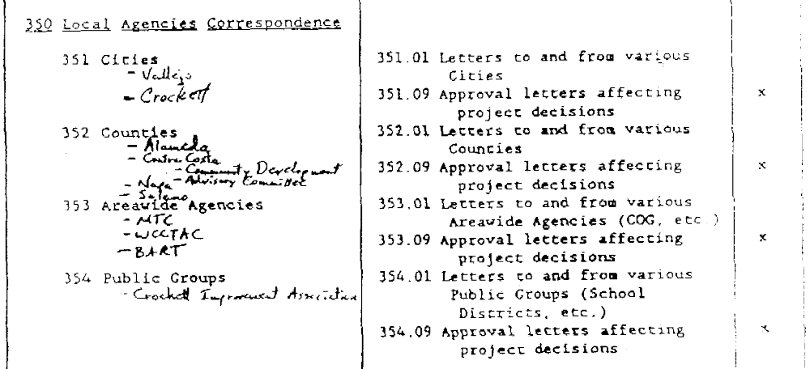
Example: Document Management

Slide 36
Example: Document Management
Documents and categories
  the category structure is not just how the work is done; it is an object of the work
  considering how the categories mediate views of the document space
Making categories meaningful
  communicating categorisations
  externalising customisations
  contextualising document codings

Slide 37
Design Principles
Computation is a medium

Slide 38
Design Principles
Users, not designers, manage meaning
Users, not designers, manage coupling

Slide 39
Design Principles
Embodied interaction participates in the world it represents

Slide 40
Design Principles
Embodied interaction turns action into meaning

Slide 41
Design Principles
Embodied interaction relies on the manipulation of meaning on multiple levels

Slide 42
Implications
Information appliances
  the conundrum of appliances and convergence
  an issue of coupling and boundaries
The invisible user interface
  engagement and coupling
  interface-in-use is continually shifting
Physical and symbolic
  the persistence of symbolic interaction

Slide 43
Conclusions
Embodiment is a foundation for new HCI models
  tangible and social computing
  a common focus on participation and meaning
Turning to phenomenology
  a conceptual understanding of embodiment
6 design principles
  steps towards an account of embodied interaction

